Slide 2
The Business Case for Coaching in Healthcare
Retention
Retaining professional healthcare providers is vital. The replacement costs, particularly for these providers, professionals and administrators are extremely high – often double the salary for those who leave.
Engagement and Satisfaction
A more advanced, personalized approach to development is required to keep highly educated and skilled professionals motivated, leading to higher retention, engagement and the prevention of burnout.
Numerous studies have documented the positive impact of coaching. There are four key benefits of building a coaching culture in healthcare.
Career Advancement
Professionals need space to advance in their careers, either through
new challenges and responsibilities or being able to contribute to the state
of the art in healthcare.
Career Extension
New roles beyond retirement, extend service, reduce their clinical workloads, develop a cadre of coaches, creates a pathway for developing the next generation of leaders.

Slide 3
Relevant Trends in Healthcare Coaching
Senior leaders are becoming more proactive and selective about who to coach within the organization – often leaders need to have a performance conversation, which they don’t know how to have.
More training for leaders to coach – more leadership development so they interface effectively with administrators and colleagues.
More coaching for senior leaders where there is a sense of sadness or discontent.
Coaching executives for innovation in planning.
More Groups – efficient – peer support – sustainable
Reducing barriers for access to wellness coaching – shift culture to self care as a personal obligation.
Senior providers/chairs need to shift from sacrifice and lack of self care to model balance. “Coaching requires quite a bit of confidence and courage to cut through this level of impression management”
Realize when to bring in professional coaches outside the organization when talent leaders coach those who can hire/fire… there is always an underlying agenda.
Teaming – across all provider model balance. Effective team coaching is new in this space.

Slide 4
The Great Resignation or Quiet Quitting?
For Physicians?
It can also be the great reprioritization which results in the “great reduction” – and, a request to work less hours.
Nurses and Other Providers
Mid-level, they may not leave the practice of medicine, but they can be hired away easily for perceived better cultures, more pay or less hours.
These trends change the frame for coaching in healthcare. HCI brings cohorts together who are committed to change the conversation and the cultures in organizations.

Slide 5
Coaching… The great disruptor and tool for leading change
Our unique approach to teaching coaching skills for healthcare professionals is based on two core beliefs:
The most effective coaching conveys ownership of outcomes in a change agile and learning culture
Leadership that embraces coaching begins with deep listening and a dialog that starts with, “what can you imagine?”

Slide 6
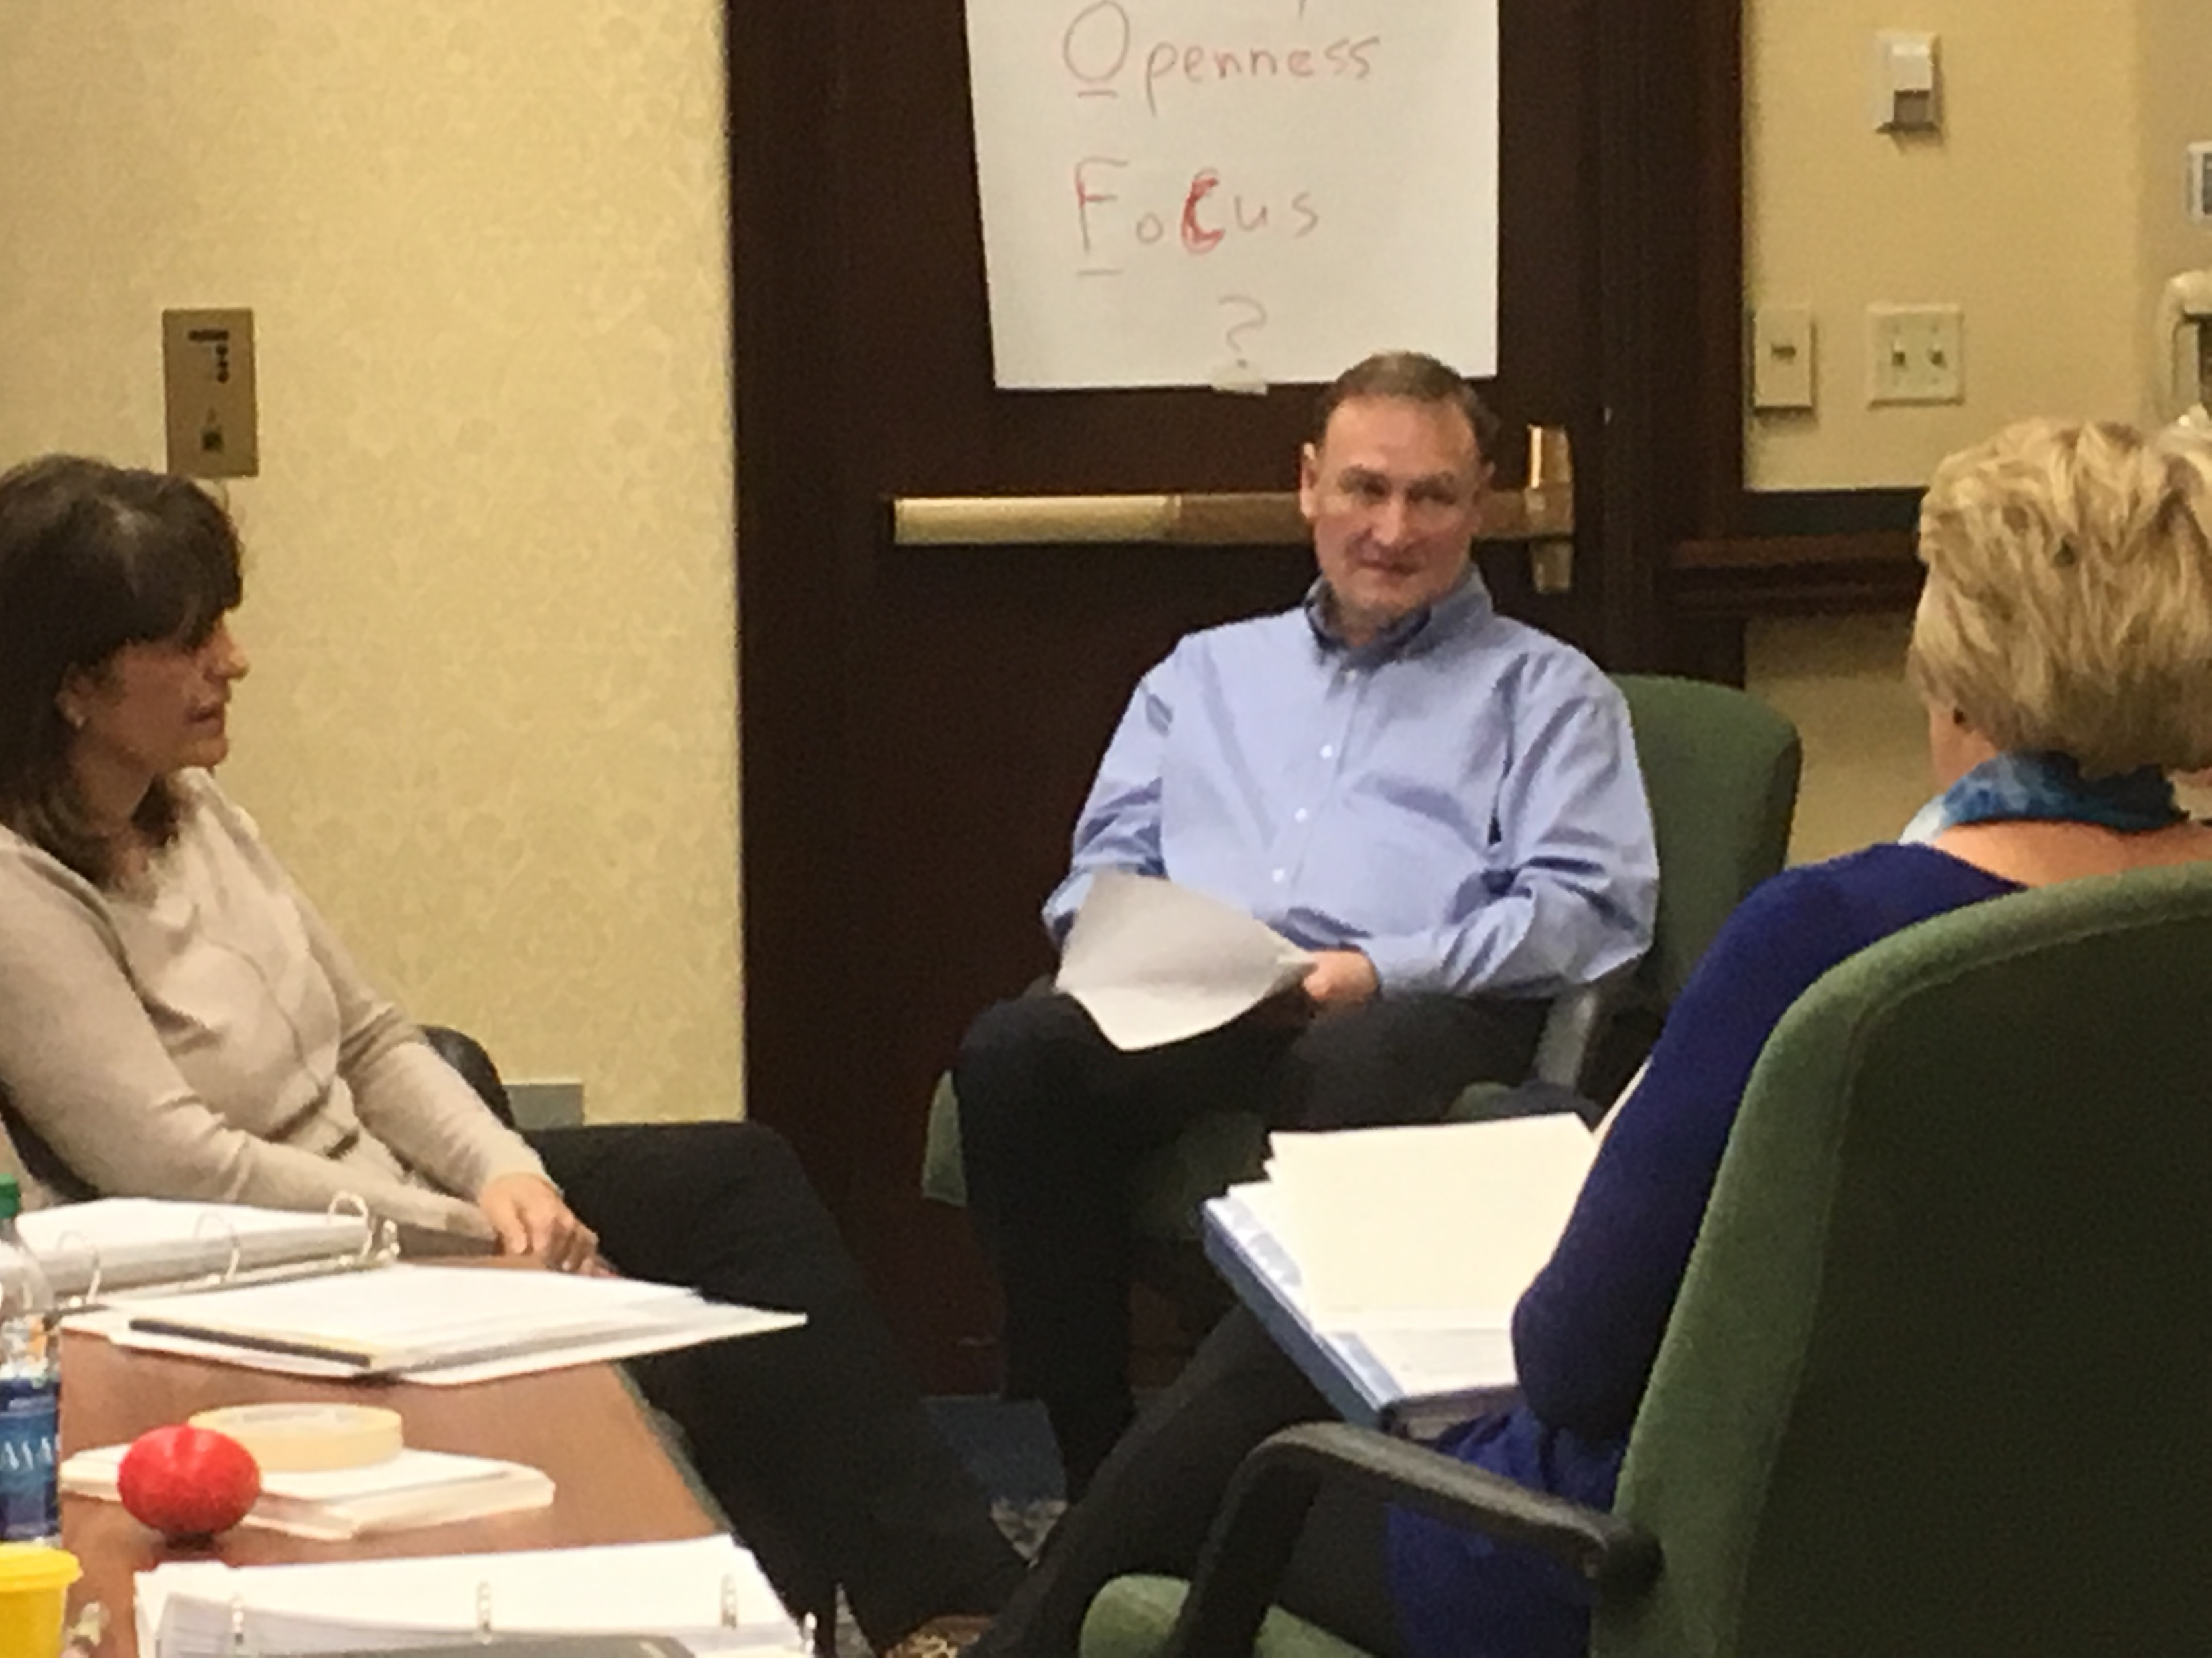
What is Coaching?
The International Coaching Federation (ICF) defines coaching as partnering with clients in a thought-provoking and creative process that inspires them to maximize their personal and professional potential, which is particularly important in today’s uncertain and complex environment.
Coaches honor the client as the expert in his or her life and work and believe every client is creative, resourceful, and whole.

Slide 7
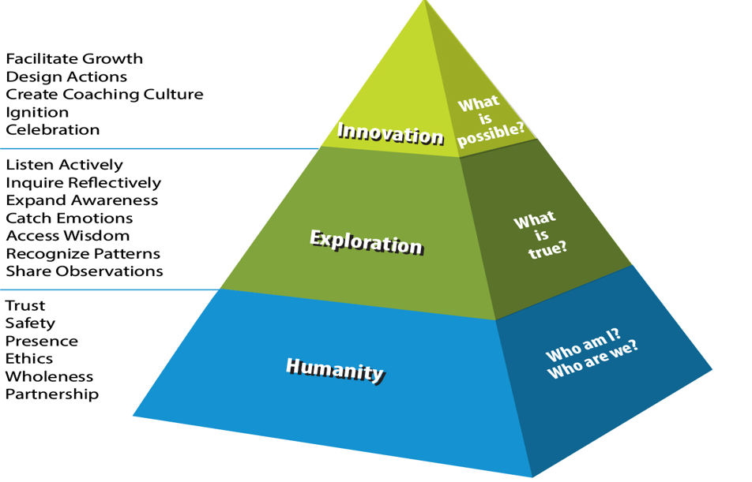
Coach Competency Development Model

Slide 8
Healthcare Coaching Programs for NCHL
NCHL Leadership Coach Certification Coach training to become self-aware, wholly curious, and compassionate through introduction and practice of a conversational model and coach competency toolkit that satisfies coursework and mentoring requirements for foundational leadership coach certification. (ICF Associate Coach Certificate). This special 64 Hour Course includes three virtual intensives, weekly two-hour virtual classes and mentor labs.
Leader as Coach Program Virtual 7-Week Program with 2-hour highly experiential sessions carrying 16 CMEs and CCEUs (Continuing Coach Education Units).
Bridge to PCC Available to coaches who hold a Level One or ACC credential and seek continuing coach education and preparation for the PCC credential

Slide 9
NCHL Level One Leadership Coach Certification
Special Offer NCHL Program for 2025, Convenes August 26, 2025, 7-9PM through January 20th, 2026
Prerequisite: NCHL LENS Member, Leadership Experience, completion of a FREE ethics course
Course objective: Completion of an ICF Level One (ACC) HCI Certification and prepares participants for ICF ACC credential
Includes 10 mentor sessions, 7 group and 3 individual recording reviews with mentor faculty
Eight seats reserved for LENS members – until seats are filled – rates on following page
Classes Include:
Convene the cohort – 90 min – Evening of Introductions on August 26th.
Foundational Intensive #1 – What is Coaching? Introduces the ICF Core Competencies and the HCI Conversational Model – Coaching in Healthcare.
Contracting for Coaching – Assessing Coachability
Cultivating Self as Coach (Leader as Coach) Who I am and Who we are Together
Client Systems and Patterns – Enneagram archetypes and coaching
Mentor Lab #1 – Establish Desired Outcome
Humanity and Healthcare Intensive #2 – Exploration – Getting to the Source - Evoking Awareness – Emotions and Motivations
Coaching in Healthcare – Complexity to Creativity
Creating a Culture of Coaching – Road Map to Agility and Change Readiness plus Introduction to Group Coaching
Intensive –Three –Deepening Skills - Facilitating Growth
Mentor Lab #2 – Prep for ICF Coach Exam
Includes Healthcare Specific classes on 2 Saturdays per month from 10:00-11:30AM – coaching the healthcare leader and leaders in transition

Slide 10
Rates for Leadership Coach Certification
Course Fees:
LENS Premium Members: $8,000
Other NCHL Members: $8,750
Non-LENS Members: $9,500
Class Size:
8 Seats reserved for NCHL, this includes all mentoring requirements.
Students enrolled on a first come, first served basis – up to 8 for NCHL as participants come from various healthcare communities and partnerships.
Enrollment information:
Open Enrollment opens: Now
Open Enrollment Closes: April 15th, 2025
Pre-work sent before June 1st, includes:
Link to ICF Ethics Course through ICF (no additional charge)
Student Questionnaire for onboarding and community building.
Enneagram Assessment – cost covered
*$1,000 reserves seat now (non-refundable)
Payment in full must be received by April 15th, 2025

Slide 11
New to NCHL – “Healthcare Leader as Coach”
Comprehensive Essential Leadership Coaching Course with Mentor Review Practice
Purpose: Distinguish many roles each leader plays and when to coach for development and when to lead, manage, mentor, or train. Prepare leaders to use a Core Skills coaching framework to:
Distinguish Key Roles – Leader, Mentor, Trainer, Coach
Expand self awareness – Who I AM and Who we are Together as Foundation for coaching - - the coach grows too!
Explore and practice a proven coaching model to bring out the best in others.
Buddy coaches assigned for practice through the 7 weeks to practice discreet skills building assignments from each class.
Cohorts of 10 min-20 max: Ideal for Faculty, HROD, Directors, Chairs, Vice Chairs, mentors at any level! This is our first open enrollment program. Contact us for inhouse programs if that is a better fit. Delivery:
Virtual 7-Week Program for 2-hour highly experiential sessions with like minded professionals
Workbook and session handouts
Qualifies for 16 CMEs and CCEUs (Continuing Coach Education Units)

Slide 12
2025 Rates for “HCI Leader as Coach”
Course Fees:
LENS Premium Members: $ 2,850
Other NCHL Members: $ 3,200
Non-LENS Members: $ 3,750
Class Size:
10 minimum and up to 20 Seats
Tentative schedule = Options
April – May: Wednesdays 12-2PM EDT
or Fridays – TBD
or mid summer TBD
Dates TBD mid December, 2024. Let us know interest!!
Email DJ@pyramidresource.com

Slide 13
New to NCHL – Bridge to PCC Program
For Coaches seeking continuing coach education and preparation for the PCC credential who have completed our NCHL Signature, Level One course. This continuation is for an additional. . .
49.5 hours of coach specific training
39 hours of core skills and 10.5 hours of healthcare focused coach training
One individual coaching session with faculty mentor
5 additional mentoring lab hours
Core skills Courses
Business of Coaching * Organizational Systems * Mastering the Language of Archetypes * Group and Team Coaching * Mentor Labs
Healthcare Specific Classes
Coaching the Healthcare Leader * Mindfulness * Reigniting Passion and Purpose, Coaching the Disillusioned * Applications/Integrations for Healthcare

Slide 14
2025 NCHL Special Rates for Virtual Bridge to PCC
Course Fees:
$3,500/person for NCHL Members
Contact us for more info: Admin@pyramidresource.com
Class Size and Schedule:
Only 5 seats available – be among the first to enroll and join a group of 10 physician and talent leaders who continue their PCC education through May!
January 2025 – May 2025
Brochures posted on the Pyramid Resource Group website:
www.pyramidresource.com
Go to Coach Training and download Bridge to PCC Program Winter – Spring 2025
Or see brochure in the breakout room at NCHL Conference November 19th!

